Slide 1
Joint meeting CITCEA-BSC
2 Nov 2023

Slide 2
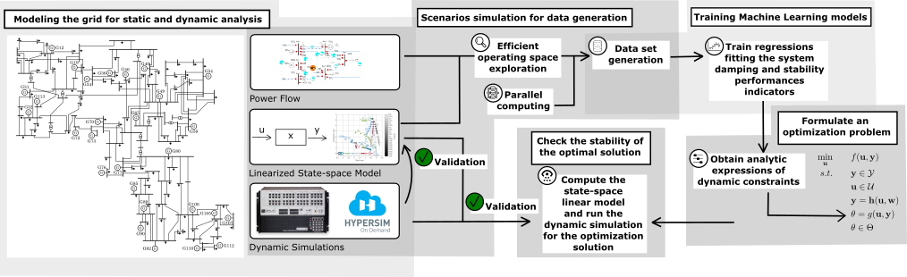
Small-signal Stability Constrained Optimal Power Flow Tool
OPF with dynamic constraint, to suggest the system operator the generation dispatch and the converters controllers tuning which guarantee an optimal and stable operation.
The dynamic constraint is formulated as a data-driven surrogate model (through a regression) of conventional small-signal analysis.
A training data set is required, collecting the small-signal stability response of the system for several operating point and converters controllers tuning

Slide 3
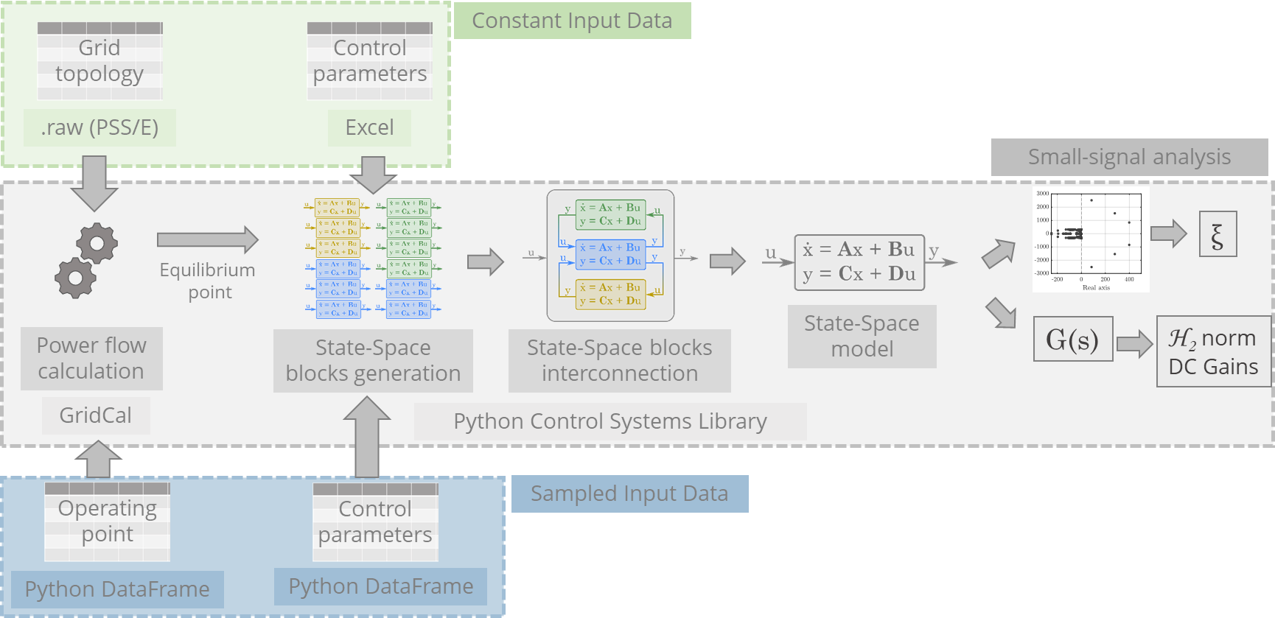
Data Generation - Small-signal Analysis

Slide 4
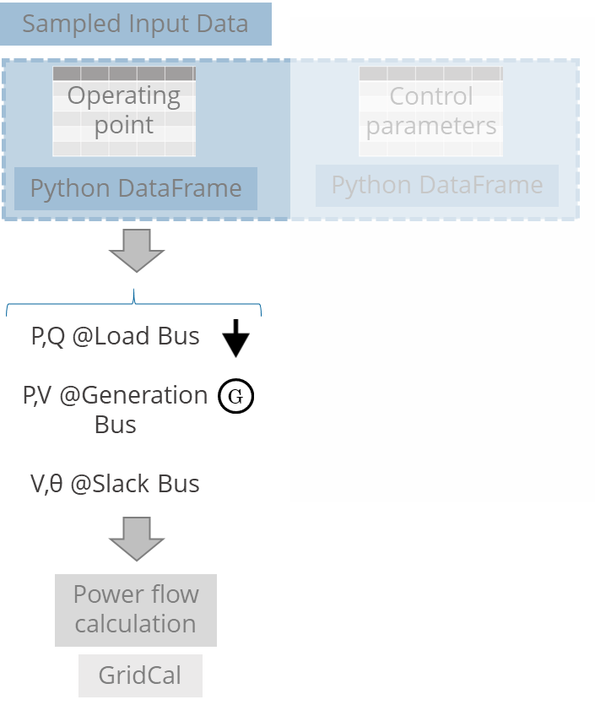
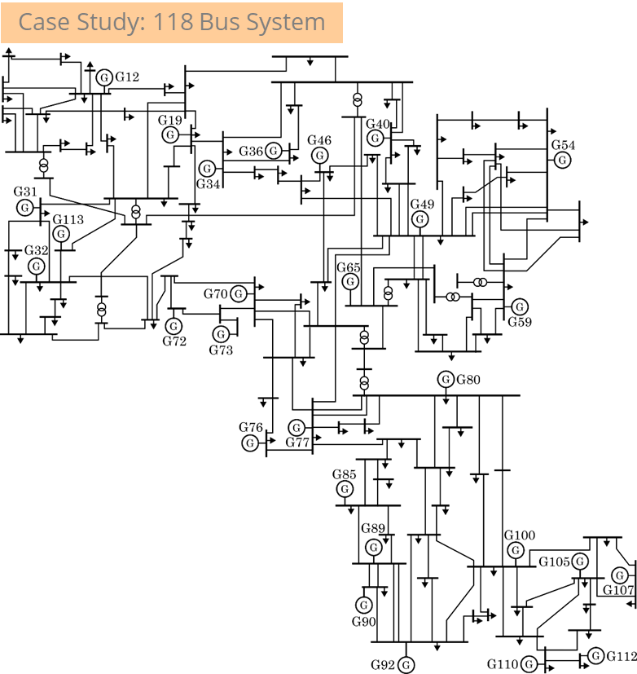
Data Generation - Data to sample

Slide 5
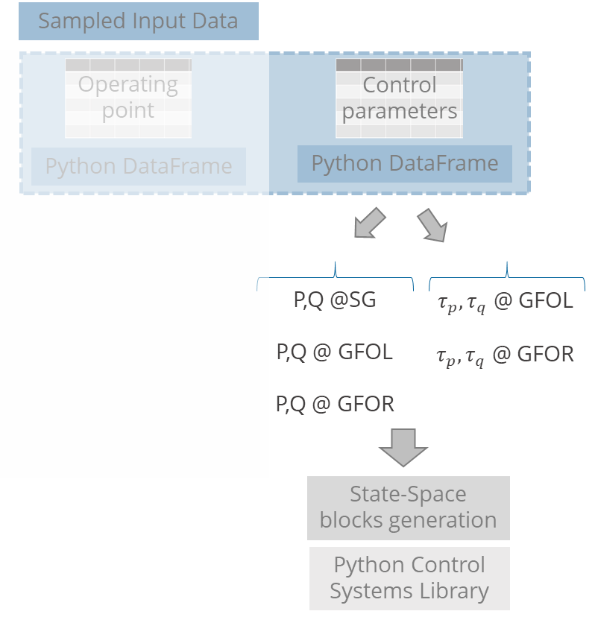
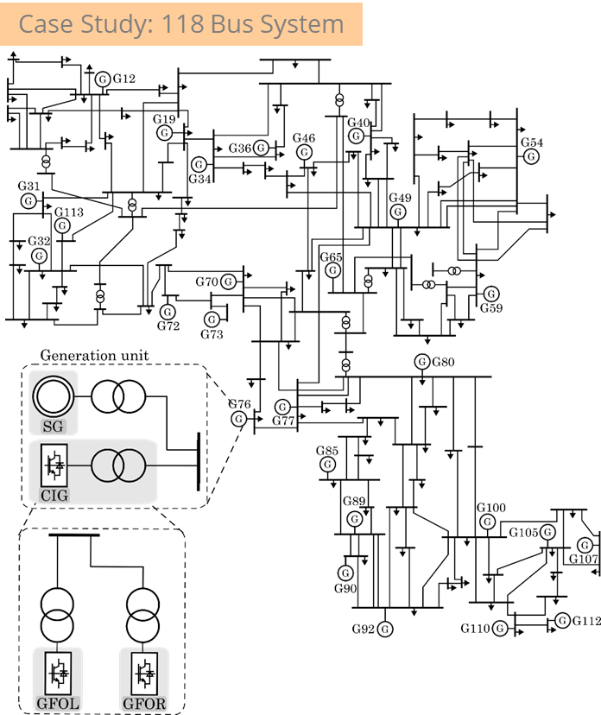
Data Generation - Data to sample
SG: Synchronous
Generator
CIG: Converter
Interfaced
Generator
GFOL: Grid-following
control
GFOR: Grid-forming
control
System elements:
- 28 Generation buses
-91 Loads buses
-172 Lines
-9 Transformers

Slide 6
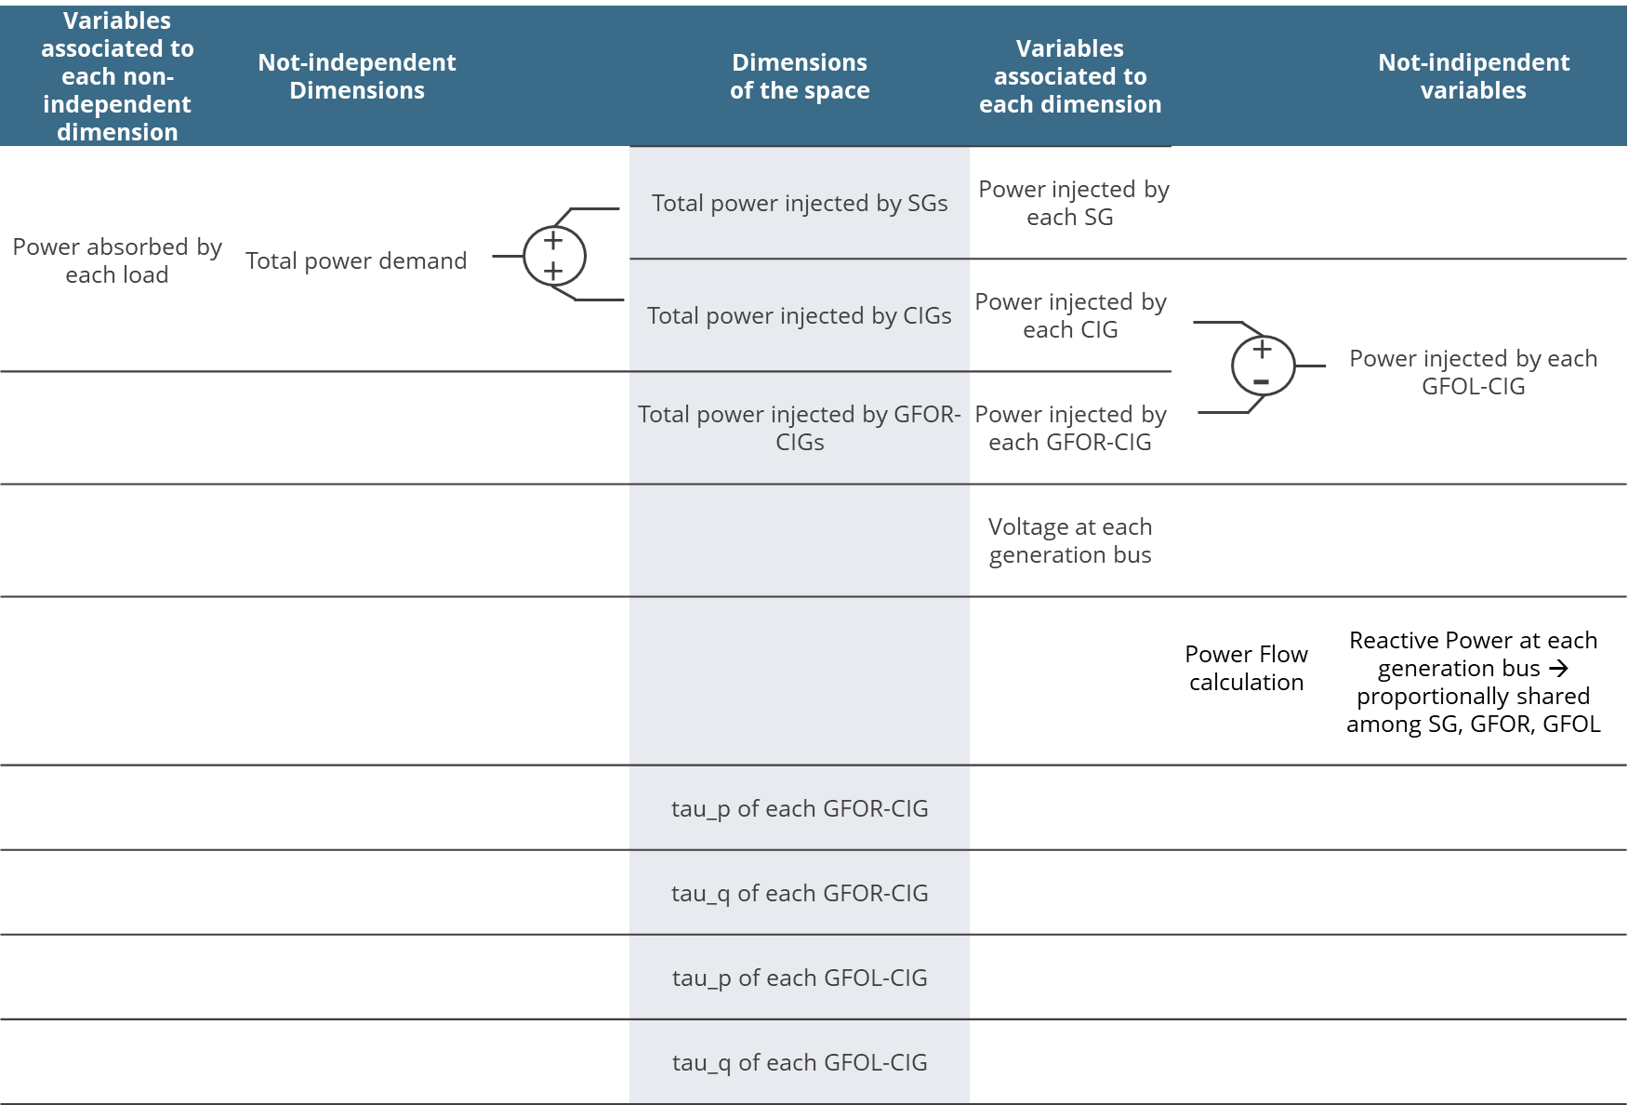
Data Generation - Data to sample

Slide 7
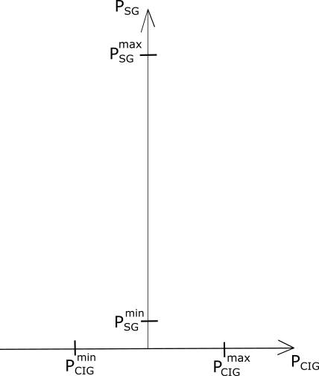
Data Generation - Data to sample
Generators size and minimum and maximum demand adapted from :
Pena, Ivonne, Carlo Brancucci Martinez-Anido, and Bri-Mathias Hodge. "An extended IEEE 118-bus test system with high renewable penetration." IEEE Transactions on Power Systems 33.1 (2017): 281-289

Slide 8
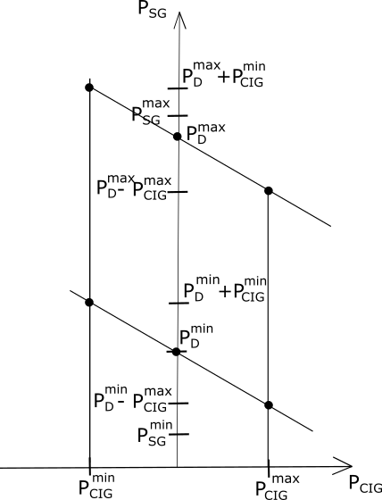
Data Generation - Data to sample
Generators size and minimum and maximum demand adapted from :
Pena, Ivonne, Carlo Brancucci Martinez-Anido, and Bri-Mathias Hodge. "An extended IEEE 118-bus test system with high renewable penetration." IEEE Transactions on Power Systems 33.1 (2017): 281-289

Slide 9
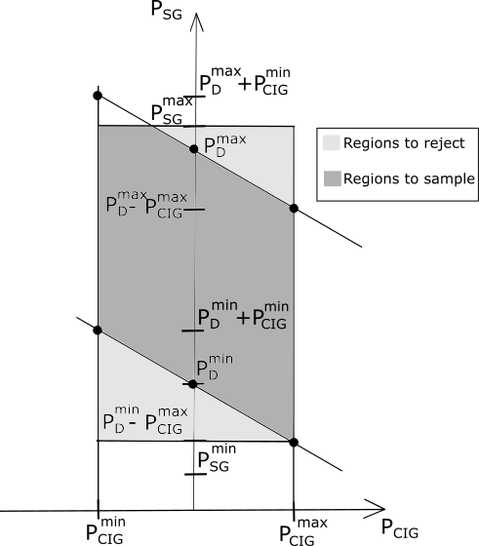
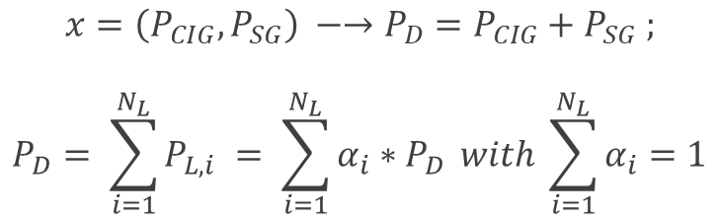
Data Generation - Data to sample
Generators size and minimum and maximum demand adapted from :
Pena, Ivonne, Carlo Brancucci Martinez-Anido, and Bri-Mathias Hodge. "An extended IEEE 118-bus test system with high renewable penetration." IEEE Transactions on Power Systems 33.1 (2017): 281-289
x

Slide 10

Data Generation - Data to sample
→ Between 0-100% →

Slide 11
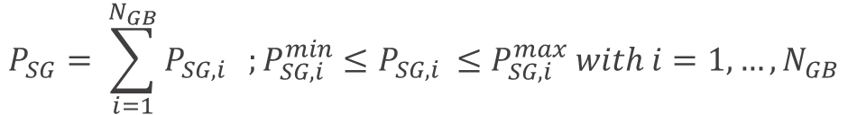
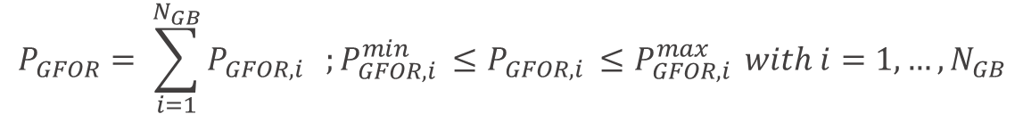
Data Generation - Data to sample

Slide 12
Data Generation - Data to sample
→ Random voltage profile:
→ Random parameters values in a conventional range

Slide 13
Data Generation Application

Slide 14
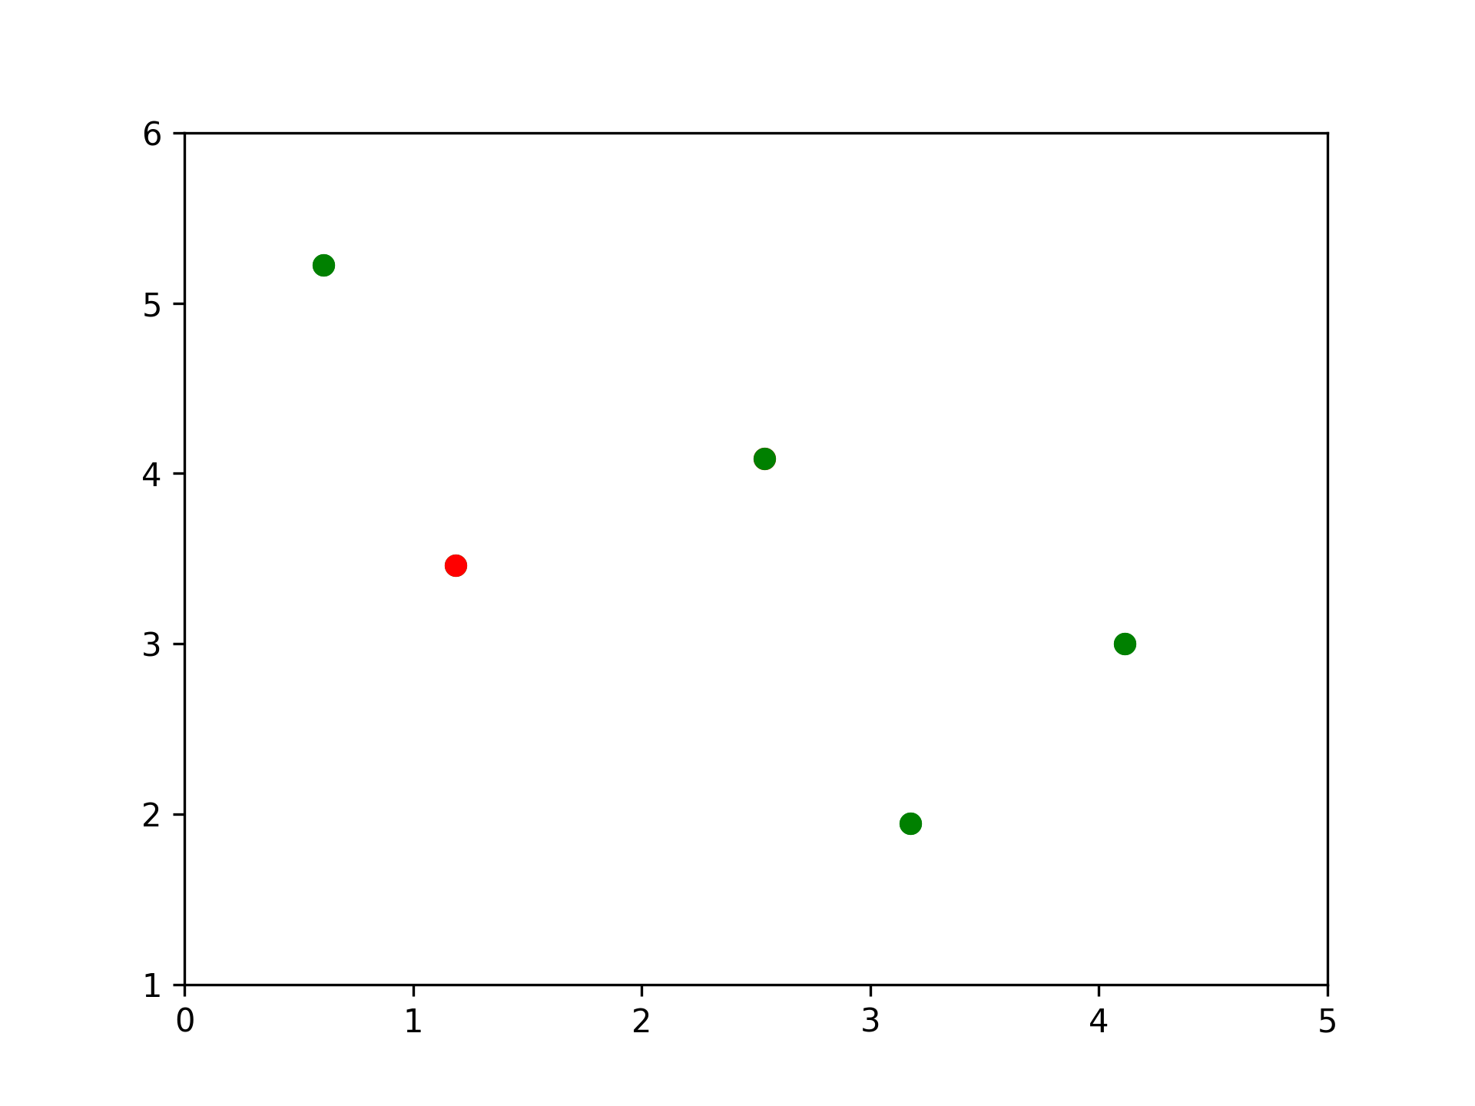
App structure - Sampling
Random generators
Sampling
Entropy analysis
Analysis
Stop criteria
Sensitivity analysis
Subdivision

Slide 15
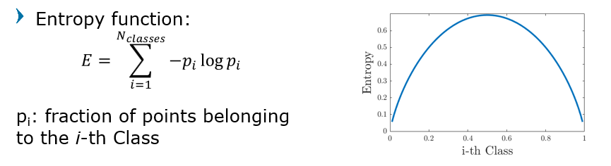
App structure - Entropy analysis
Random generators
Sampling
Entropy analysis
Analysis
Stop criteria
Sensitivity analysis
Subdivision

Slide 16
App structure - Stop criteria
Random generators
Depth
  Max depth defined by user (before execution)
Tolerance
  Fraction of the dimensions within the first cell
  Defined by user
Delta Entropy
  Difference between current entropy and the inherited one
Sampling
Entropy analysis
Analysis
Stop criteria
Sensitivity analysis
Subdivision

Slide 17
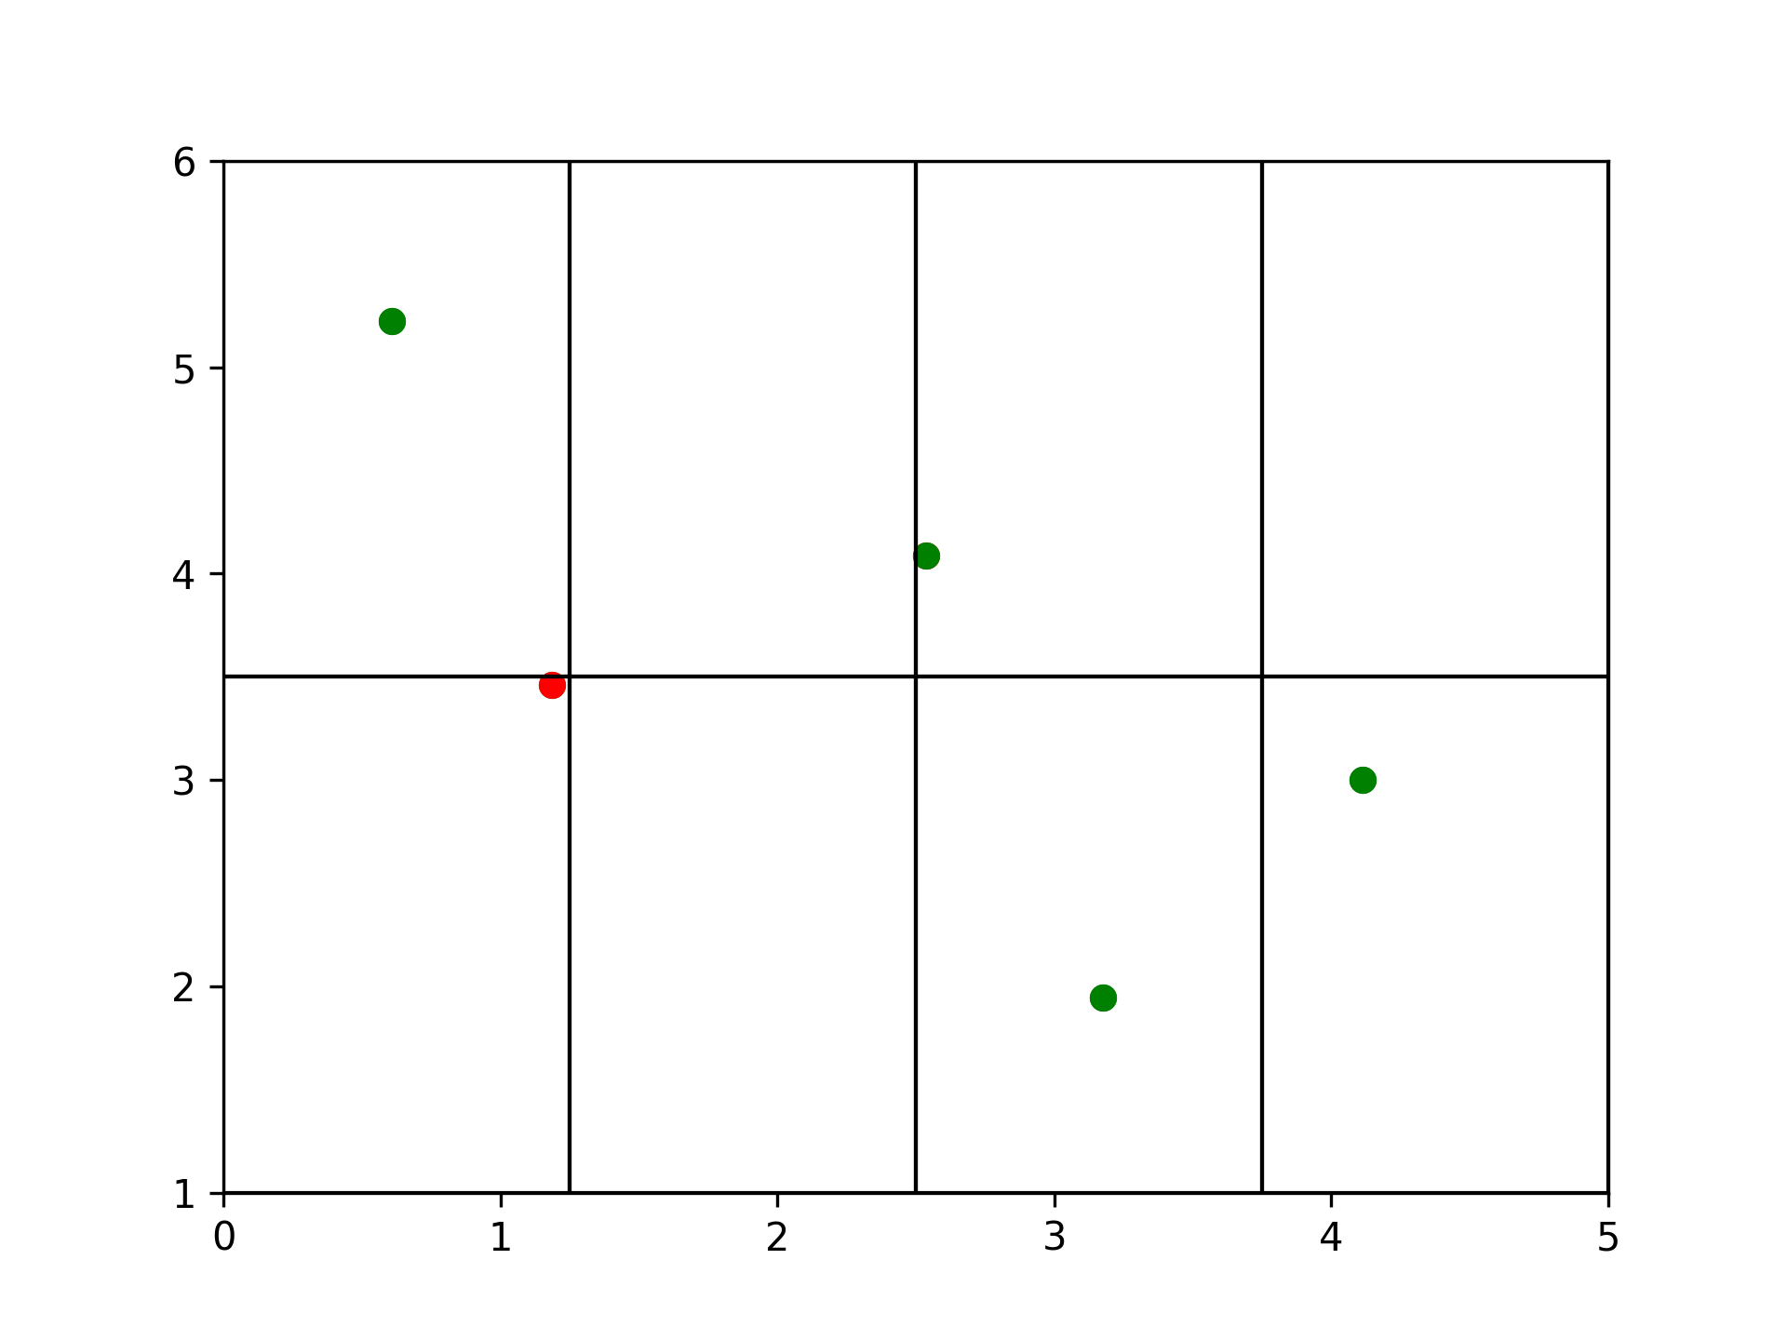
App structure - Subdivision
Random generators
Sampling
Entropy analysis
Analysis
Stop criteria
Sensitivity analysis
Subdivision

Slide 18
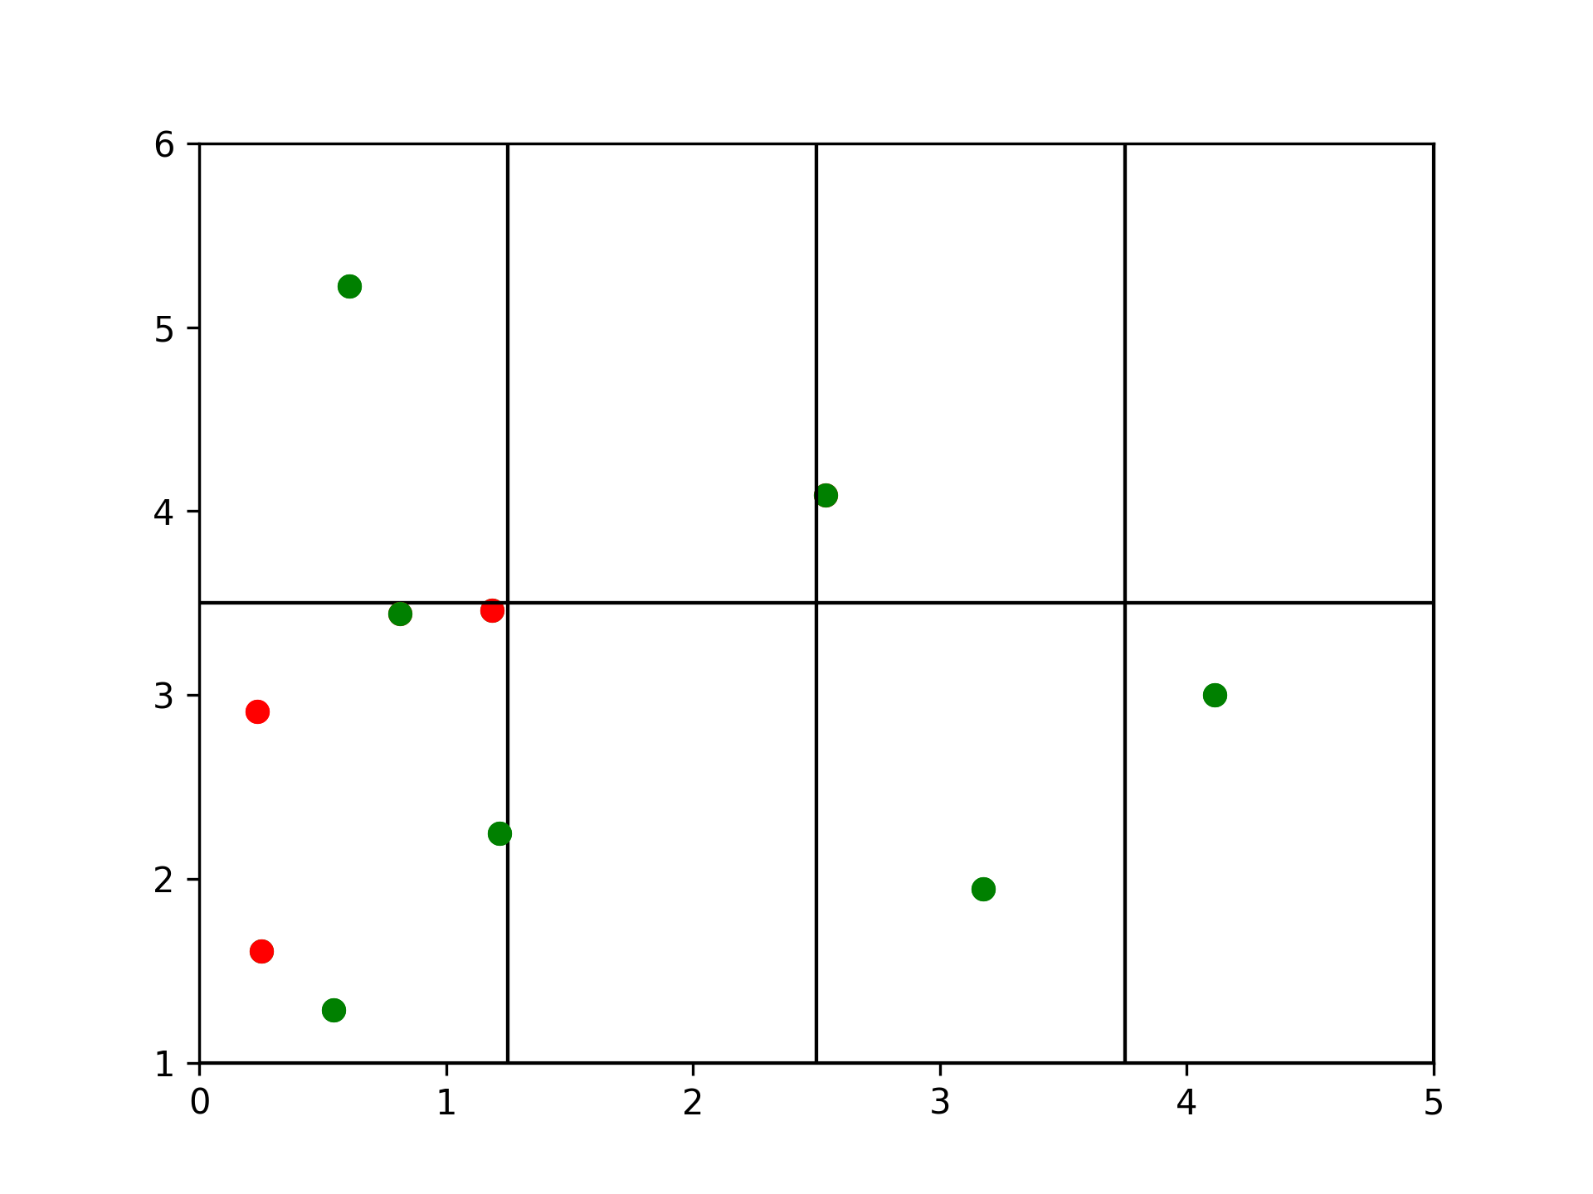
App structure - Sampling
Random generators
Sampling
Entropy analysis
Analysis
Stop criteria
Sensitivity analysis
Subdivision

Slide 19
Random sampling functions
Normal generator
  Normal distribution centered around the means of the variables, so that they sum to the desired value
Extreme generator
  Assign random values to variables until they sum to the desired value

Slide 20
Sensitivity analysis and cell division
Pre-defined divisions
  User assigns dimensions divisions
  Constant through all execution
  It does not fit the characteristics of the explored region
Sensitivity analysis
  Performed by each cell
  Random Forest based on the samples taken by the cell
  Assign subdivisions according to the importances of each dimension in the decision

